Slide 1
RESEARCH PROJECT
RESEARCH PROJECT
ON
ONLINE BANKING OF INDIA
BY : DEVANSHI BHASIN
ROLL NO. : BAP/19/514
SECOND YEAR
DU , MSC 22”🎓

Slide 2
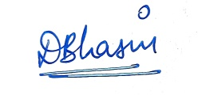
DEPARTMENT OF ECONOMICS
MATA SUNDRI COLLEGE .
CERTIFICATE !
THIS IS TO CERTIFY THAT DEVANSHI BHASIN A STUDENT OF 2ND YEAR HAS COMPLETED THE RESEARCH PROJECT ON THE TOPIC ONLINE BANKING OF INDIA UNDER THE SUPERVISION OF MRS.DIVYA KHETAN DURING THE YEAR 2020-2021 ASSIGNED BY THE ECONOMICS DEARTMENT , UNIVERSITY OF DELHI
NAME OF STUDENT NAME OF TEACHER
DEVANSHI BHASIN MRS. DIVYA KHETAN

Slide 3
ACKNOWLEDGEMENT !
I WOULD LIKE TO EXPRESS MY SPECIAL THANKS OF GRATITUDE TO MY ECONOMICS TEACHER MRS. DIVYA KHETAN FOR HER ABLE GUIDANCE AND SUPPORT IN COMPLETING MY PROJECT .
I WOULD ALSO LIKE TO EXTEND MY GRATITUDE TO THE PRINCIPAL DR.HARPREET KAUR FOR PROVIDING ME WITH ALL THE FACILITY THAT WAS REQUIRED .
DATED : DEVANSHI BHASIN
19 OCTOBER 2020 BAP/19/514

Slide 4
INDEX
TOPIC SLIDE No.
TOPIC of STUDY 3
ABSTRACT 3
INTRODUCTION 3
REVIEW of LITERATURE 6
LIMITATIONS OF E-BANKING 8
FEATURES OF E-BANKIG 9
MERITS OF E-BANKING 10
DE-MERITS OF E-BANKING 11
WHAT IS INTERNET FRAUD ? 12
SECURITY ISSUES 13
STEPS TO MINIMISE FRAUDS 19
ONLINE BANKING & INDIAN ECONOMY 20
A CASE STUDY 23
FINDINGS 36
RECOMMENDATIONS 37
CONCLUSION 38
BIBLOGRAPHY 39
APPENDIX

Slide 5
1. TOPIC OF STUDY
NET BANKING of INDIA
ABSTRACT THE PURPOSE IS TO NOTE THE LIVELIHOOD OF CONTINUED GROWTH OF INTERNET BANKING AND COMMERCE AS IDIVIDUAL CONSUMERS PURCHASE MORE AND MORE PRODUCTS TO ACCESS THE INTERNET AND COMPLETE BOTH FINANCIAL AND CONSUMERS TRANSACTIONS .
3. INTRODUCTION ONLINE BANKING , IS THE TERM THAT DESCRIBES ALL TRANSACTIONS THAT TAKE PLACE AMONG COMPANIES ,
ORGANISATIONS AND INDIVIDUALS AND THEIR BANKING INSTITUTIONS . FIRST CONCEPTUALIZED IN THE MID 1970’s , SOME BANKS OFFERED CUSTOMERS ELECTRONIC BANKING IN 1985 .

Slide 6
PROBLEM OF STUDY
IN GENERAL , ONLINE BANKING SITES AND MOBILE APPS ARE DESIGNED TO BE SECURE AND BANKS ARE CONTINUALLY PUTTING UPDATED SECURITY PROTOCOLS IN PLACE.
OBJECTIVE OF STUDY
* TO UNDERSTAND THE GENESIS AND CONCEPT OF ONLINE BANKING .
* TO ANALYSE THE IMPORTANCE , FUNCTIONS , ADVANTAGES AND LIMITATIONS OF ONLINE BANKING.
*TO HIGHLIGHT THE SECURITY PROBLEMS AND HOW TO REDUCE IT.
*TO ANALYSE THE TREND .
* TO ANALYSE THE PRESENT E-BANKING SCENARIO .
* TO EXAMINE THE IMPACT OF ATM , INTERNET BANKING , CREDIT CARDS ON CUSTOMER SATISFACTIONS .

Slide 7
RESEARCH DESIGN
Internet banking system is a method in which a personal computer is connected to internet by an internet service provider directly to a host computer system of a bank such that customer service requests can be processed automatically without need for intervention by customer service representatives.
CONCLUSION
Internet banking is changing the banking industry and is having the major effects on banking relationships.  The net banking, thus, "now is more of a norm rather than an exception in many developed countries" due to the fact that it is the economical way of providing banking services.

Slide 8
4. REVIEW OF LITERATURE
WHAT IT MEANS ?
*AN INTRODUCTION TO E-COMMERCE
*INTRODUCTION TO INFORMATION
TECHNOLOGY AND BUSINESS
APPLICATION
HOW TO DO IT ?
1.Visit the Net Banking registration page.
2.Enter your customer ID and confirm your mobile number to generate an OTP.
3.Enter the OTP.
4.Select your debit card and enter details.
5.Set your IPIN.
6.Login to Net Banking using your customer ID and new IPIN.

Slide 9
4.Select your debit card and enter details.
5.Set your IPIN.
6.Login to Net Banking using your customer ID and new IPIN.
FOR INSTANCE
SBI net banking facility can be used through mobiles, laptops and tablets and account holders do not have to even visit the bank branch in order to register for SBI internet banking facility. In order to register online, you will need your SBI ATM card, account number, CIF, branch code and registered mobile number.

Slide 10
5. LIMITATIONS OF STUDY
THE MAJOR LIMITATIONS OF THE STUDY ARE :
1.A SMALL SAMPLE SIZE OF 114 RESPONDENTS ARE TAKEN TO PRIMARY DATA ANALYSIS . SO, I CANNOT DRAW PROPER INFERENCES ABOUT THE RESPONDENTS FROMTHIS SAMPLE SIZE .
2.I HAVE NOT USED MODERN STATISTICAL TOOLS TO ANANLYSE THE DATA .
3.DUE TO SHORTAGE OF TIME , I HAVE NOT BEEN ABLE TO MAKE A DEPTH STUDY.
4.THIS STUDY IS BASED ON THE PREVAILING RESPONDENTS SATISFACTION. BUT THEIR SATISFACTION MAY CHANGE ACCORDING TO TIME ,FASHION , NEED , ETC.

Slide 11
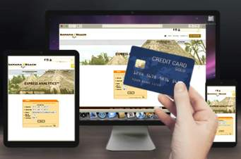
6.FEATURES OF NET BANKING
1.Check the account statement online.
2.Open a fixed deposit account.
3.Pay utility bills such as water bill and electricity bill.
4.Make merchant payments.
5.Transfer funds.
6.Order for a cheque book.
7.Buy general insurance.
8.Recharge prepaid mobile/DTH.

Slide 12
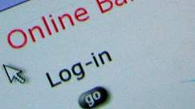
7.MERITS OF NET BANKING
1. 24/7 account and service access.
2. Speed and efficiency.
3. Online bill payment.
4. Low overhead can mean low fees.
5. Low overhead can mean high interest rates on deposit accounts .

Slide 13

8.DEMERITS OF BANKING
While these disadvantages may not keep you from using online services, keep these concerns in mind to avoid potential issues down the road.
1.Technology and Service Interruptions. 2.Security and Identity Theft Concerns. 3.Limitations on Deposits.
4.Convenient but Not Always Faster.
5.Lack of Personal Banker Relationship.

Slide 14

9.WHAT IS INTERNET FRAUD?
Internet fraud is a type of fraud which makes use of the internet. It is not a single fraud, there are numerous frauds under that. Internet fraudsters are everywhere and they come up with innovative tricks to cheat people and wipe out money from their bank account. In this blog, we will discuss the type of internet frauds

Slide 15
10. SECURITY ISSUES OF NET BANKING !
Understanding the security issues relating to Internet banking can help you keep both your personal and business accounts safe from intruders.
TYPES OF INTERNET FRAUD
1. PHISHING OR EMAIL SCAM
It is a method used by fraudsters to steal your personal information. Under this fraud, fraudsters send you emails by posing as a genuine or reputed company. The primary intention of sending those emails is to steal your bank details. These emails usually will have a link or attachment. If you click on those links, you will be taken to a fake website. The fake website will ask you to provide your sensitive information like card details, UPI code and other bank details. Also, clicking on such links will lead to a virus attack on your computer.

Slide 16
2. ONLINE SHOPPING FRAUDS
It is one of the biggest internet frauds since the past few years. Under this, fraudsters set up fake online shopping portals with the intention of cheating innocent people of their hard-earned money. In the website, they display attractive product at a very cheap rate. But, after the purchase is made by paying the money, either the fake product is delivered or the product is not delivered at all. These websites will not have any return or refund policies and also there will be no customer support team to contact.
3. IDENTITY THEFT
Under identity theft, your personal information is stolen by fraudsters through the internet and used to apply for a personal loan, two-wheeler loan or a credit card with a bank. When loans are availed in your name, you will be responsible for its repayment. Banks will send you the notice for repayment. If the loan is not repaid it will have a bad impact on your credit score and you will be marked a loan defaulter. Also, the stolen information of yours can be used to create fake social media accounts.

Slide 17
4. WORK FROM HOME SCAM
Work from home scam is one of the serious internet fraud. Under this, fraudsters dupe people who are looking for work from home opportunities by promising that they will earn handsome money, just by working for a few hours from home. To register for the scheme, job seekers will be asked to deposit a certain amount of money for job kit which is useful for the work. After the money is deposited, there will be no track of employers.
5. LOTTERY FRAUD
Lottery fraud is one among the top three internet frauds in India. Under lottery fraud, fraudsters call you or send emails and messages stating you have won a lottery worth rupees some crore. To receive the lottery money, you will be asked to transfer money online in the name of tax. Sometimes you will be asked to pay money by visiting fake websites. When you try to make payment using those websites, all your card details will be stolen.

Slide 18
6. MATRIMONIAL FRAUDS
In this busy lifestyle, people prefer online matrimonial sites to find their life partners. But, the sad part here is a lot of people lose lakhs of money while finding their soulmates on the matrimonial sites. Fraudsters dupe innocent people by creating fake profiles. Also, there are many gangs set up to carry out this fraud. Under this fraud, first, fraudsters make victims believe them. Once the trust is created, money is looted from the victims.
7. Tax scams
This fraud normally takes place during the tax season when taxpayers will be waiting for their tax refund. Fraudsters send fake refund SMS and emails to taxpayers claiming to be from the income tax department. These notifications are mainly sent with the intention of collecting their personal information like login details of I-T Department website, bank details and so on. To credit the refund money to your bank account, you will be asked to provide your sensitive bank information.

Slide 19
8. CREDIT CARD REWAR POINTS FRAUD
Reward points or loyalty points are offered by the credit card companies to promote the usage of a credit card. Frauds are also taken place in the name of credit card reward point. Fraudsters call credit cardholders claiming to be from their credit card company and tell them that they would help them in redeeming their credit card reward point. They create urgency among cardholders stating offer will end very soon. To redeem the reward points, cardholders will be asked to provide their card details along with OTP. Fraudsters carry out fraudulent transactions using these details.
9. FRAUDS ON OLX
Frauds on OLX have become very common and many people have lost their money while buying and selling products on the website. The fraud which normally takes place on OLX is, fraudsters pose as Army personnel and post their advertisement on the website. Fraudsters use the stolen Id card of army personnel to make people trust them. They collect money from the buyer for the advertised product but they will never deliver the product. Here goodwill associated with the armed forces is used by fraudsters to cheat people of their hard-earned money.

Slide 20

10. SOCIAL MEDIA FRAUDS
With the number of people using social media, social media frauds are on the rise. Cyber Bullying is one of the biggest social media fraud to which many teenagers have fallen prey. Under Cyber Bullying social media sites are used to bully people. Also, there are many other social media frauds like a Facebook friend fraud .

Slide 21
11. STEPS TO MINIMISE SECURITY ISSUES !
INSTALL LATEST SECURITY SOFTWARE
USE AUTO UPDATE FOR ALL SOFTWARE
LOOK FOR ENCRYTION SIGNS
USE DIFFERENT SOFTWARES
CASH ON DELIVERY OPTION
DEALING WITH OFFERS
CHECK WEBSITES DIGITAL CERTIFICATE
AVOID USING PUBLIC COMPUTERS
STAY AWAY FROM PHISHING EMAILS SEEKING CONFIDENTIAL INFORMATION
BUY FROM REPUTED MERCHANTS

Slide 22

12. ONLINE BANKING SCENARIO WITH INDIAN ECONOMY !
The Indian Banks are the backbone of Indian financial sector and Indian economy. Now a day in Indian economic scenario, the Indian financial system is in a process of rapid transformation. ... Online users of banking transactions percentage was just about 1% in the agency's 2007

Slide 23
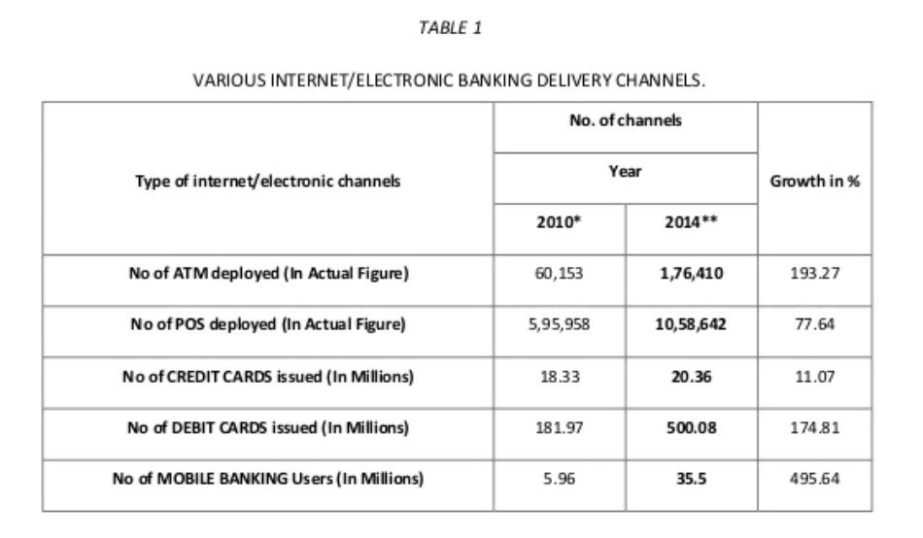

Slide 24
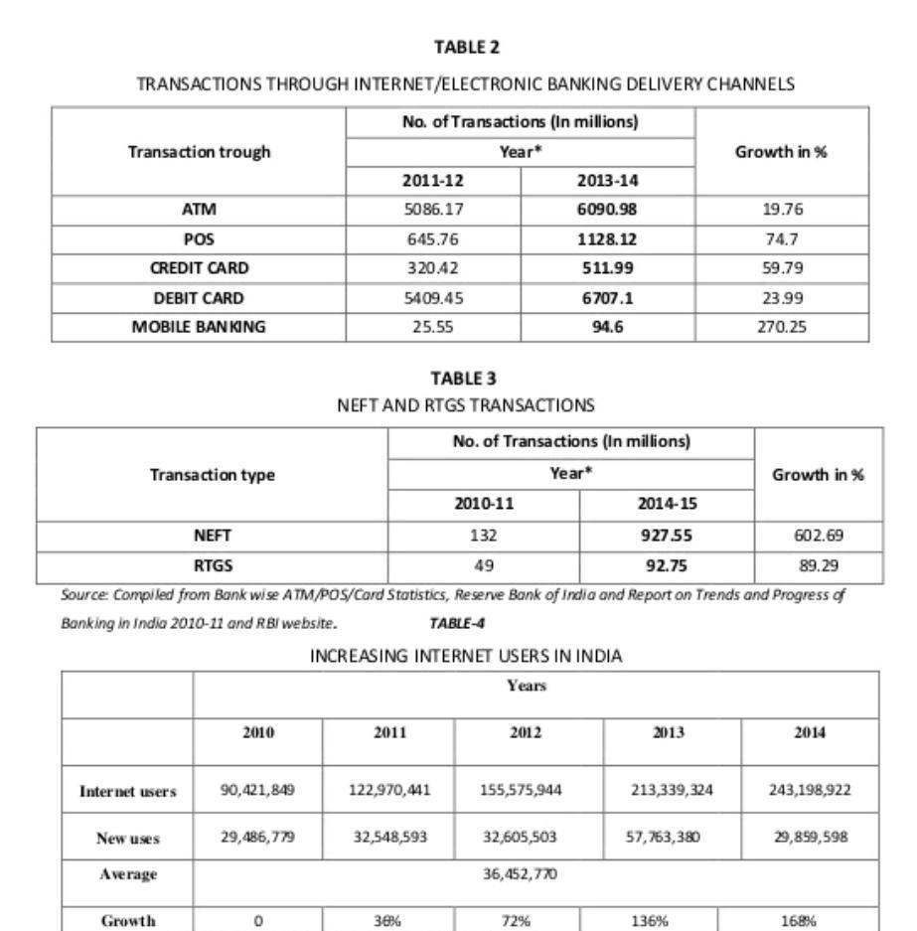

Slide 25
13. A CASE STUDY ON ONLINE BANKING !
MAINLY THE OBJECTIVE OF THE RESEARCH IS TO UNDERSTAND ONLINE BANKING USERS BEHAVIOURS , OPINIONS , PREFERENCES AND EXPECTATIONS. THE QUESTIONS WERE DESIGNED IN SUCH A WAY TO COVER ALL THE RELATING FIELDS . THE FIELD WORK AND DATA ANALYSIS WERE CONDUCTED BY ME AFTER CONSULTING WITH MY SUPERVISOR . I AM VERY MUCH GRATEFUL TO THEM .
TARGET POPUATION LOCAL PEOPLE
SURVEY METHOD DIRECT INTERVIEW , PHONE CALL
AND SOCIAL MEDIA
EFFECTIVE RESPONSE 87.71% (100 OF 114)

Slide 26
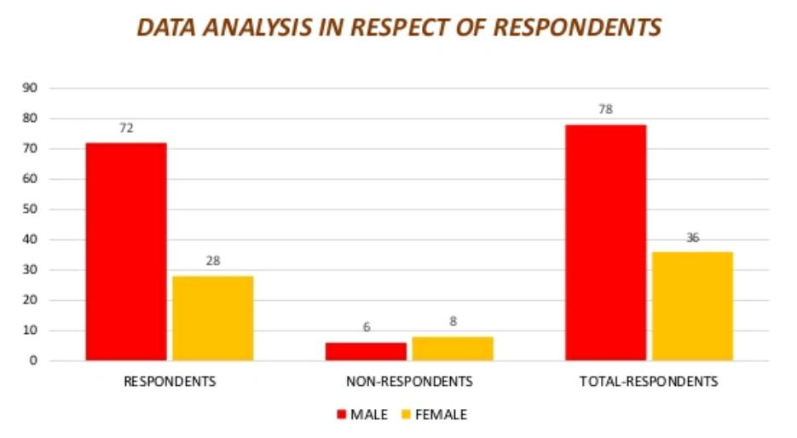
DATA ANALYSIS AND INTERPRETATION !
1.GENDER BASIS ANALYSIS
PARTICULARS RESPONDENTS NON-RES. TOTAL RES.
MALE 72 6 78
FEMALE 28 8 36
TOTAL 100 14 114

Slide 27
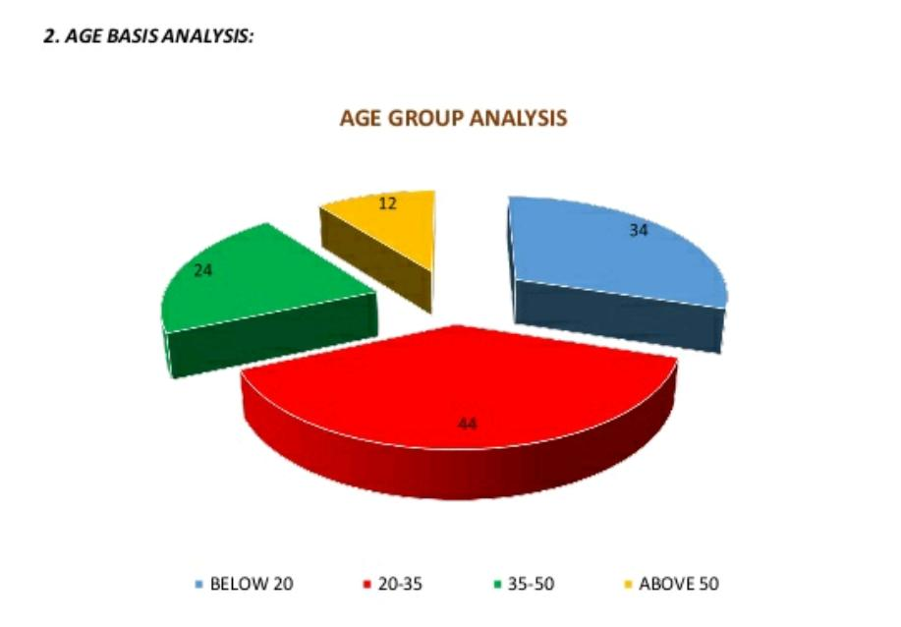
2. AGE BASIS ANALYSIS
AGE GROUP FREQUENCY PERCENTAGE CUMULATIVE FREQUENCY
BELOW 20 34 30% 34
20-30 44 38% 78
35-50 24 21% 102
ABOVE 50 12 11% 114

Slide 28
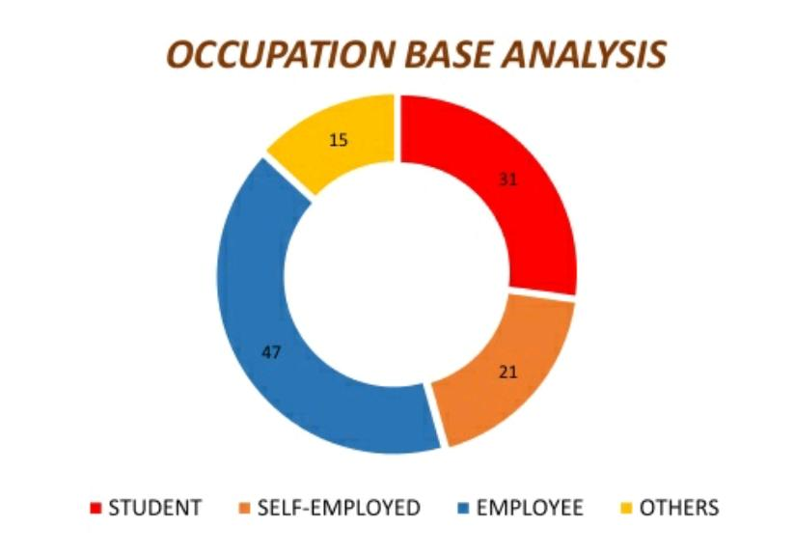
3. OCCUPATION BASIS ANALYSIS
OCCUPATION FREQUENCY CUMULATIVE FREQUENCY PERCENTAGE
STUDENT 31 31 27%
SELF EMPLOYED 21 52 18%
EMPLOYEE 47 99 41%
OTHERS 15 114 14%

Slide 29
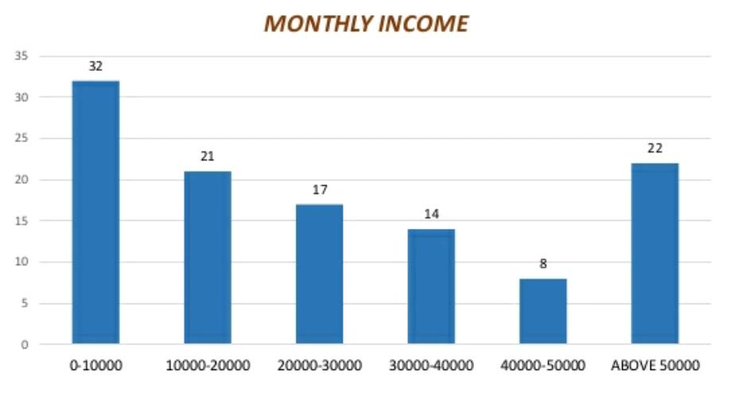
]
4. INCOME BASIS ANALYSIS
MONTHLY INCOME FREQUENCY CUMULATIVE FREQUENCY PERCENTAGE
0-10000 32 32 28%
10000-20000 21 53 18%
20000-30000 17 70 15%
30000-40000 14 84 12%
40000-50000 08 92 7%
ABOVE 50000 22 114 20%

Slide 30
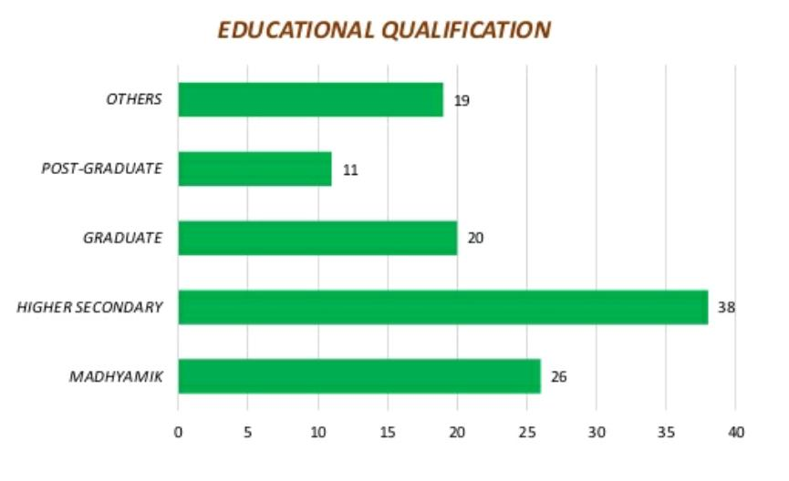
5. EDUCATIONAL PROFILE
EDUCATIONAL QUALIFICATION FREQUENCY PERCENTAGE CUMULATIVE FREQUENCY
MADHYAMIK 26 23% 26
HIGHER SECONDARY 38 33% 64
GRADUATE 20 18% 84
POST – GRADUATE 11 9% 95
OTHERS 19 17% 114

Slide 31
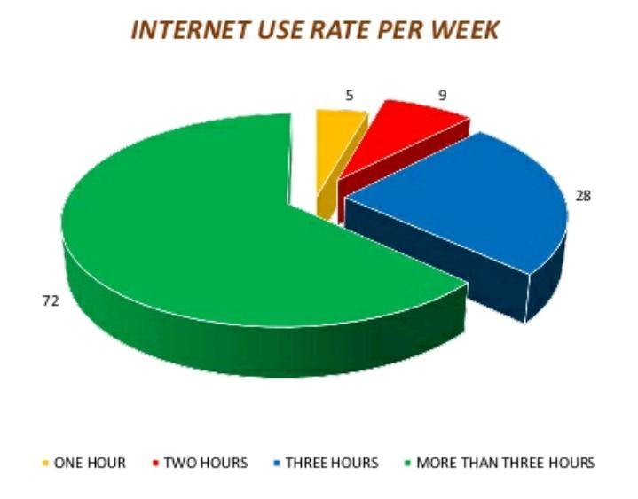
6. HOW OFTEN DO YOU USE INTERNET PER WEEK ?
INTERNET USE RATE FREQUENCY PERCENTAGE CUMULAIVE FREQUENCY
ONE HOUR 5 4% 5
TWO HOURS 9 8% 14
THREE HOURS 28 25% 42
ABOVE THREE HOURS 72 63% 114

Slide 32
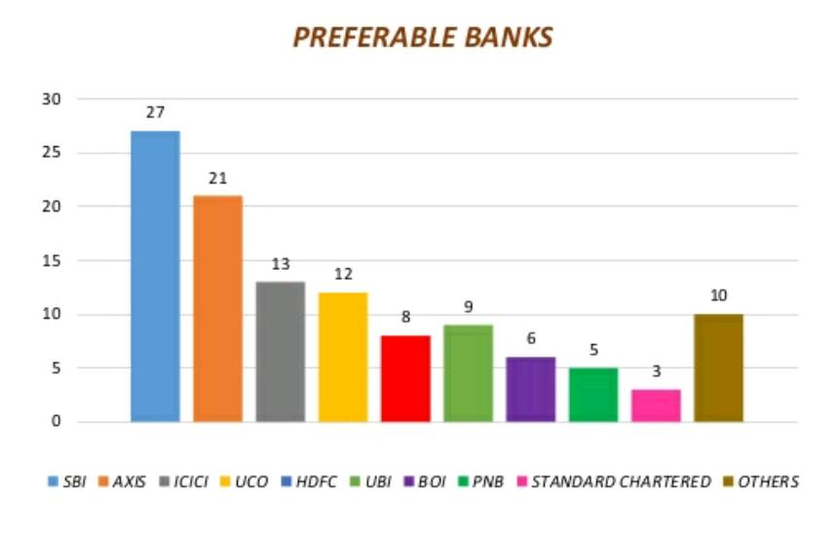
7. IN WHICH BANK DO YOU HAVE AN ACCOUNT ?
NAME OF BANKS FREQUENCY PERCENTAGE CUMULATIVE FREQUENCY
SBI 27 24 % 27
AXIS 21 18 % 48
ICICI 13 11 % 61
UCO 12 10 % 73
HDFC 8 7 % 81
UBI 9 8 % 90
BOI 6 6 % 96
PNB 5 5 % 101
SC 3 2 % 104
OTHERS 10 9 % 114

Slide 33
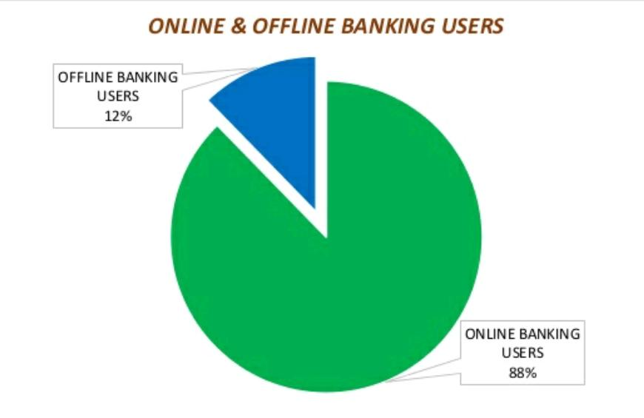
8. DO YOU AVAIL BANKING FACILITIES ONLINE ? ?
PARTICULARS FREQUENCY PERCENTAGE CUMULATIVE FREQUENCY
ONLINE 100 88 % 100
OFFLINE 14 12 % 114

Slide 34
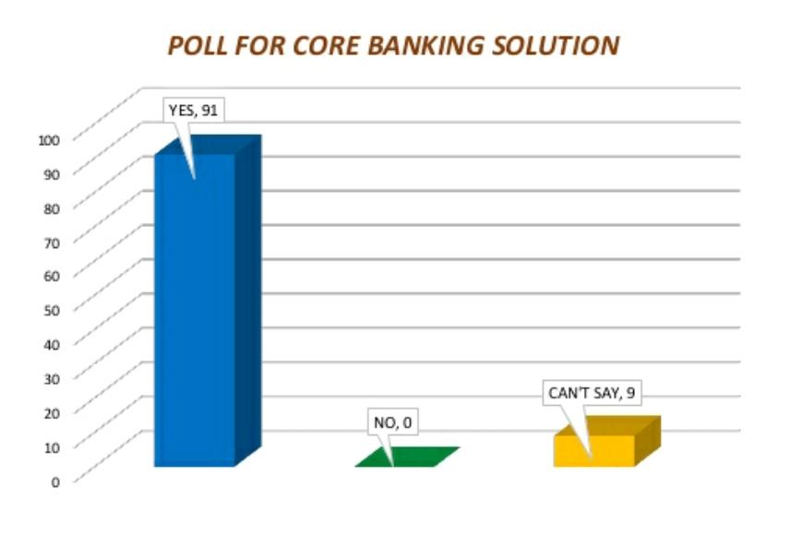
9. IS YOUR BANK OPERATED UNDER CORE-BANKING FACILITY?
CORE BANKING FACILITY FREQUENCY PERCENTAGE CUMULATIVE FREQUENCY
YES 91 91 % 91
NO 0 0 % 91
CAN’T SAY 9 9 100

Slide 35
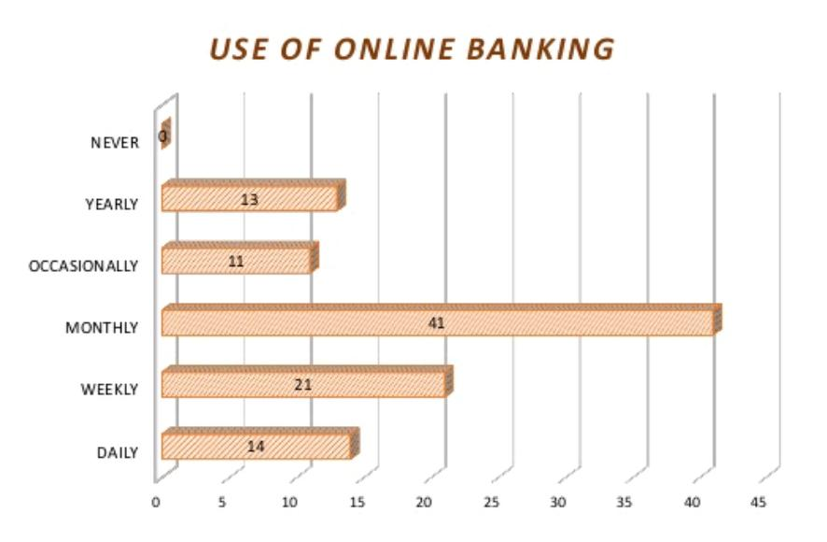
10. HOW FREQUENTLY DO YOU USE ONLINE BANKING SERVICES ?
USAGE FREQUENCY PERCENTAGE CUMULATIVE FREQUENCY
DAILY 14 14 % 14
WEEKLY 21 21 % 35
MONTHLY 41 41 % 76
OCCASIONALLY 11 11 % 87
YEARLY 13 13 % 100
NEVER 0 0 % 100

Slide 36
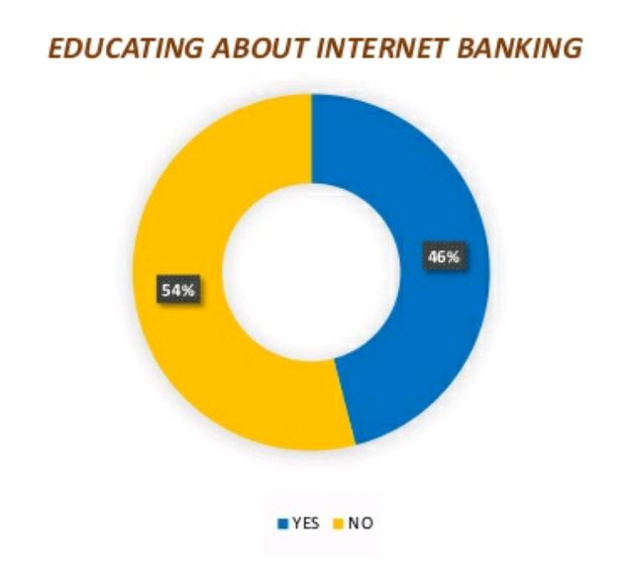
11. DOES YOUR BANK EDUCATE YOU ABOUT HE ONLINE BANKING SERVICES BEING OFFERED ?
EDUCATION FREQUENCY PERCENTAGE CUMULATIVE FREQUENCY
YES 46 46 % 46
NO 54 54 % 100

Slide 37
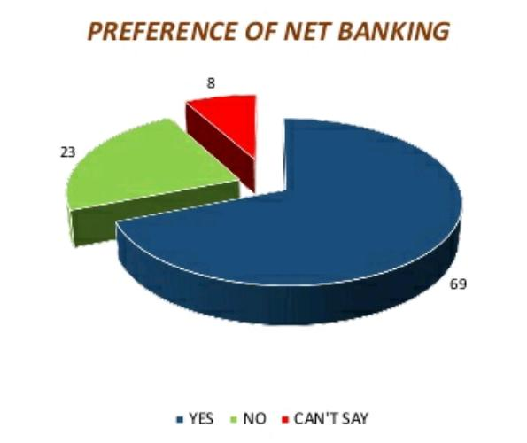
12.DO YOU THINK ONLINE BANKING IS A GOOD SUBSTITUTE OF TRADITIONAL BANKING SERVICES ?
PREFERANCE FREQUENCY PERCENTAGE CUMULATIVE FREQUENCY
YES 69 69 % 69
NO 23 23 % 92
CAN’T SAY 8 8 % 100

Slide 38
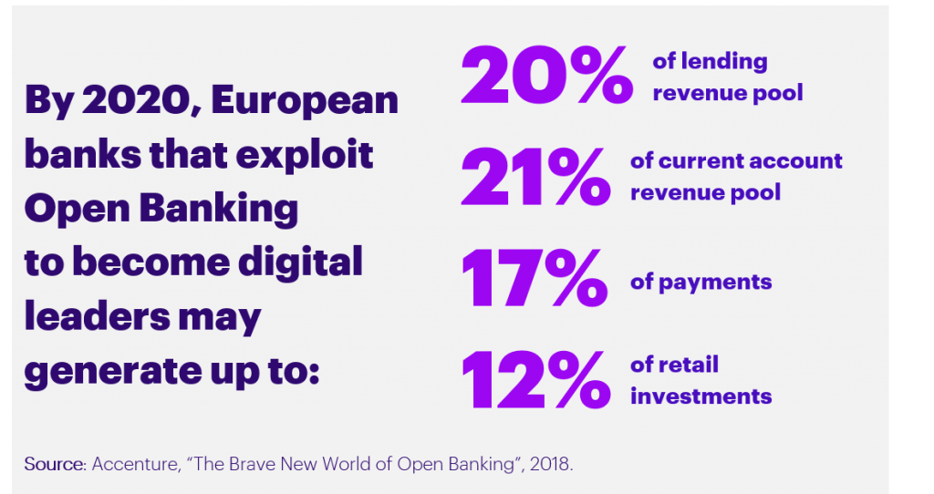
14. FINDINGS !
The findings shows that cash withdrawal , Checking of account , Opening of account through online internet , transfer of funds ,online information and bill payment are the important advantages availed through e-banking.

Slide 39

14. RECOMMENDATIONS !
To reach maximum number of prospecting internet banking customers and banking staff should take initiative to inform them e-banking services provided by the bank. Bank should effectively design its websites as a service providing mechanism and it should also give information beyond the services offered by bank.

Slide 40

15. CONCLUSION !
A bank account is not only about saving money, it's also about managing money. Opening an account is a smart move - it means that you can access a service that helps you control your money, and which may help you borrow at some time in the future, if you need to do so.

Slide 41

16. BIBLOGRAPHY !
www.slideshare.net
www.google.com
www.wikipedia.in
www.researchgate.in
www.investopedia.com
www.sbionline.com
www.sbi.co.in
www.linkedln.com
www.rbi.org.in
www.rbi.in
www.scribed.in

Slide 42
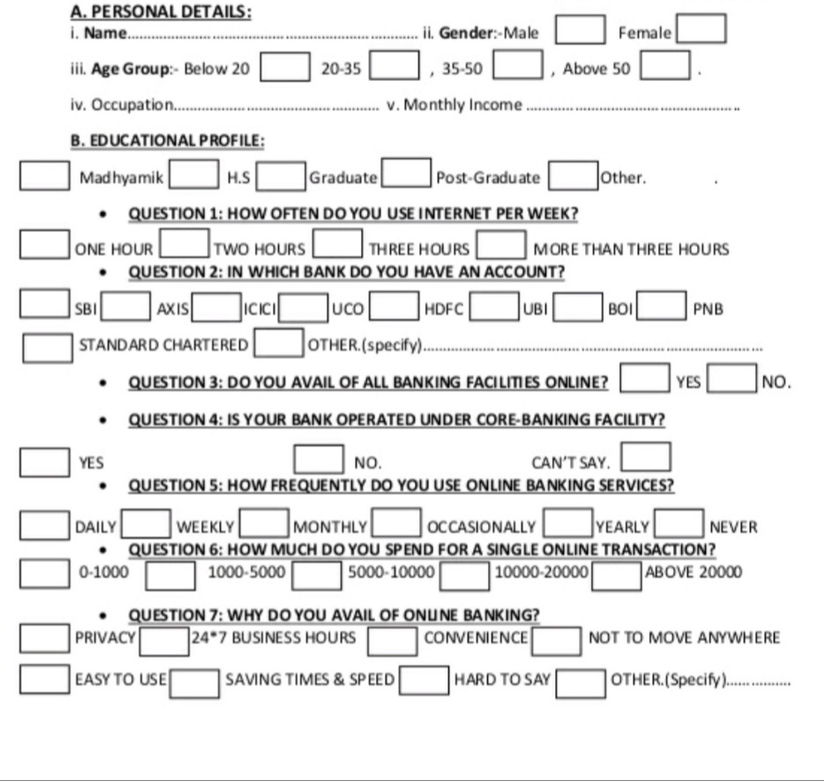
APPENDIX
A STUDY OF ONLINE BANKING IN INDIA !
QUESTIONAIRE

Slide 43
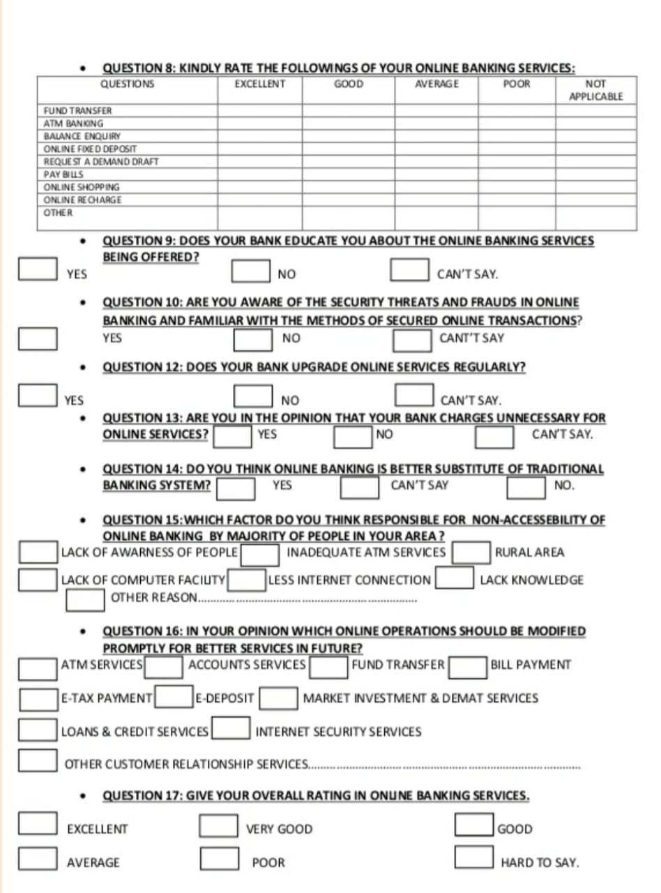

Slide 44


